Slide 1
Notes:
Hi, I’m Joshua Feist, the director of grantmaking from Arts Midwest. Just to be clear, our team at Arts Midwest facilitates the NEA Big Read grant on behalf of the NEA.
I’m here to talk more about the application process for the grant and give a little tour of where the important stuff is.

Slide 2
Eligibility
Nationwide opportunity, not just the Midwest.
Open to 501c3 non-profits, higher-ed, school districts, divisions of government, Federally-recognized tribal nations, and of course, libraries.
Not eligible? Consider partnering with an eligible organization to help host!
Notes:
Before we get into more of the nitty gritty, I just want to make sure that I address the question of eligibility since we get asked this a lot. Some folks assume that because our name is Arts Midwest that this opportunity is only open to organizations in the Midwest, but I’m happy to say that that’s not the case! It’s a nationwide opportunity and that includes the Virgin Islands, Puerto Rico, Guam, the Northern Mariana Islands, and American Samoa! If you are not eligible, you can collaborate with an eligible organization and plan your NEA Big Read together! An NEA Big Read requires the commitment and buy-in of many community partners and so you could be involved in, for example, planning and/or hosting events.

Slide 3
What is an NEA Big Read anyway?
A series of events inspired by the themes and content of one of the books in the NEA Big Read library. These events are hosted by the applicant organization and their partners to reach a broad swath of the community.
Required events: kickoff, at least 5 book discussions, 2 presentations, 2 projects inviting community response to the book.
Notes:
Let’s make sure we’re all clear on what this project grant is for.
Essentially, the goal is to get participants reading the book and engaging with it as well as other members of the community. Through the process of the whole community reading the same book at the same time, the community becomes smaller, more close knit, and people can walk a mile in another person’s shoes via the content of the book. It’s about discovering great literature, inspiring conversations, and building communities.
NEA Big Read programs you propose in your applications should be enticing to readers and non-readers alike and serve to inspire participants to read the book by engaging with the content and themes in the book. Each program you host should always tie back to the book in some way.
Now, there are some requirements outlined in the guidelines, but there is quite a bit of freedom in those requirements to tailor the program to what will resonate with your target audiences and introduce books that relate thematically. I’ll go ahead and mention those requirements now. And note that these can overlap, meaning, that you can fulfill multiple requirements with one event depending on how that event is structured.
1 kickoff event – this is your big splash, where you’re at a farmer’s market, releasing a YouTube video, or hosting your own socially-distanced parade to generate a lot of publicity in your community. The mayor could issue a proclamation and volunteers could hand out copies of the book from a safe distance.
2 presentations inspired by the content or themes of the book – panel discussions, author talk, film screenings, etc
2 community engagement projects that invite artistic response – these are much like we’ll hear from our guests on the call today - art exhibitions, theatrical performances, poetry slams, writing workshops/contests, sharing stories from the community)
5 book discussions – we have a loose definition of a book discussion in the traditional book club sense where people gather around a table in a room and talk about the book at the library. So long as there is some back and forth dialog about the book at any event, it can meet the criteria for a book discussion. For example, if you have an in-person or virtual theatrical presentation of a scene from the book and there is a talkback period with the audience afterwards, that would fulfill the criteria for a book discussion and a community engagement project.
If you’ve applied to the program in the past, you’ll notice that the programming requirements have changed a bit. We replaced the keynote with the 2 presentations element. Everything else remains the same as last year. We noticed that the vast majority of communities were meeting the two presentations criteria already.

Slide 4
Application process
Overview
Notes:
Ok, now that we have some more clarity on that, I’ll walk through the application process.

Slide 5
Timeline
Now
January 27
Mid-February to March
April
Applicants work on applications
Submit items for preliminary review; ask questions
Application deadline
Panel reviews applications remotely
Notification to all applicants
Grant agreements issued
Notes:
Here’s the general timeline of the process between now and when you’ll be notified of your application status in April.
I’d like to call out one specific bullet point under the first column. We highly encourage you to contact us at Arts Midwest to discuss any details you’re unsure about, want to run an idea past us, want us to double-check your work. We are here to support you through it all.

Slide 6
Brief tour
www.artsmidwest.org/programs/neabigread/
Notes:
Ok, if you like what you’re hearing so far, stick with me while I give a brief tour of the Arts Midwest website to show you the steps on how to apply.

Slide 7
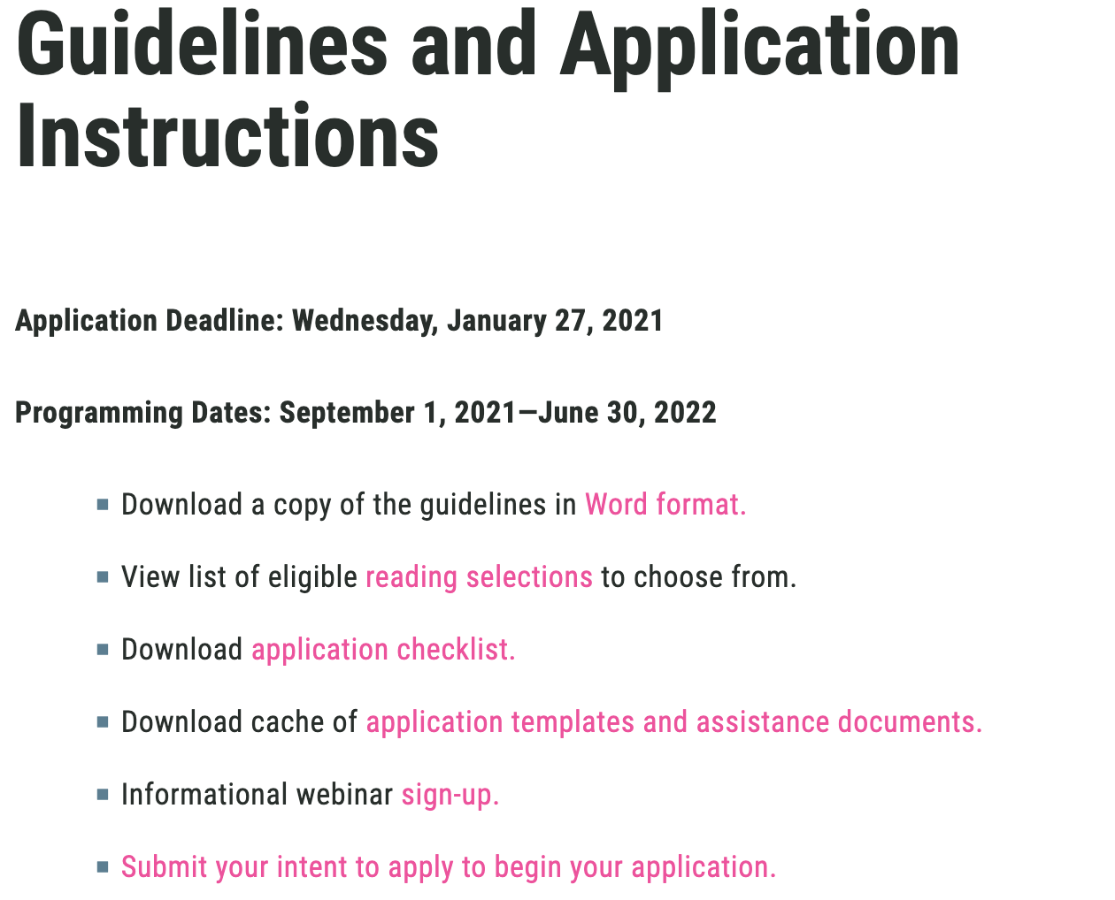
Guidelines page
www.artsmidwest.org/programs/neabigread/guidelines
Notes:
Our guidelines page is a one stop shop for grabbing a copy of the guidelines and all the supplemental documents that will help guide you through the application process. That way, you’ll have the templates you need to work from offline so that you can upload them into the online application later. I highly recommend downloading the application checklist so that you know you’ve got everything covered. By the way my segment of this presentation is following the order of steps in that document.

Slide 8
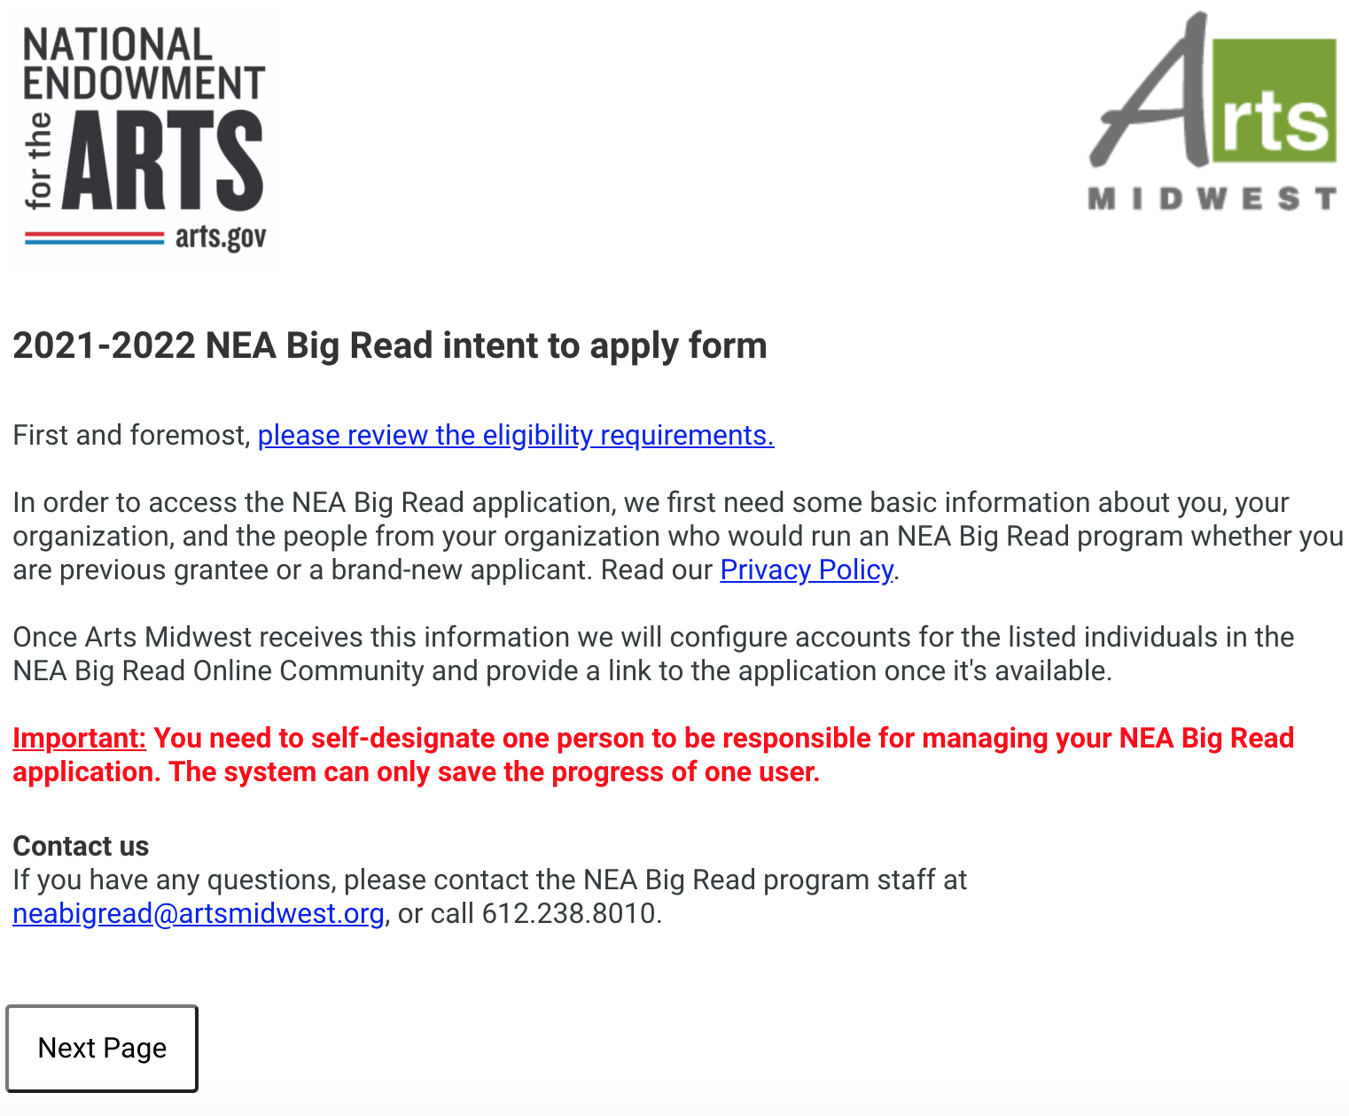
Intent to apply
www.artsmidwest.org/programs/neabigread/
Notes:
After determining your eligibility and your interest, the short intent to apply form is the next step where we’ll gather some basic info about your organization. There is a link on several places on the Arts Midwest website and we can throw one in to the chat as well.

Slide 9
Things to take care of next
DUNS number
SAM.gov registration
https://www.dnb.com/duns-number/get-a-duns.html
Quick and easy
Free
Requires DUNS number, EIN number, notarized letter
Free to establish and maintain (yearly)
Can take a up to two weeks, but not necessary to have done before applying
Assistance provided by Federal Service Desk
Notes:
This is a grant that’s derived from Federal funds and so there are certain items to take care of along the way. The first is acquiring a DUNS number if you don’t have one already. If you don’t, it’s a straightforward and quick process at the website listed here. The second task is to use that DUNS number and some other information about your organization to complete a registration at SAM.gov. This can take some time but you don’t need to have it complete by the time the application deadline rolls around. It will need to be done before we can disburse any grant funds though, should you receive an award.

Slide 10
Accessing your application
https://artsmidwest.force.com/neabigread
Notes:
After submitting the Intent to Apply form, you’ll get access to what we call “the Online Community” at the web address shown where you’ll work on your application and can chat with other applicants or past grantees in message boards organized by book.
You’ll get a follow-up email from Arts Midwest after we process your Intent to Apply that will get you in. From there, you’ll be working on your Case (or application). Navigating to your application will be explained in the follow up message from Arts Midwest but here’s a snapshot of where you’ll go to access your application.

Slide 11
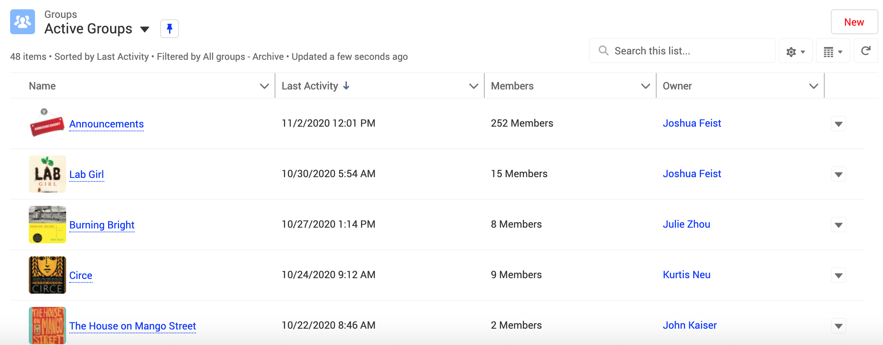
https://artsmidwest.force.com/neabigread
Notes:
Here’s a quick view of the Discuss section in the online community which you can see are message boards divided up by book or theme. So, if you’re thinking about applying for The House on Mango Street, for instance, there’s a space to chat with other prospective applicants and bounce some ideas off each other. In this community, you can chat with other applicants or current grantees but your Case files are private to the members of your application team.

Slide 12
Looking for ideas?
Artsmidwest.org
Online Community
Blog posts
News items
Discuss
Resources
Training
Arts.gov
“Stories from the Community”
Notes:
If you are in need of some further ideas about what others have done for this program you can peruse the Arts Midwest website.
Arts.gov has examples of past programming as well if you click into one of the books on their site. There’s a section of those pages for certain books labeled “Stories from the Community.” The one I find most inspiring is from Santa Barbara and their programs held amidst the Thomas Fire in 2017-2018.
And of course there’s the Online Community we just talked about with the Discuss boards but also some sections with additional resources (like potential bulk distibutors for books) and training videos (like how to host a book discussion).

Slide 13
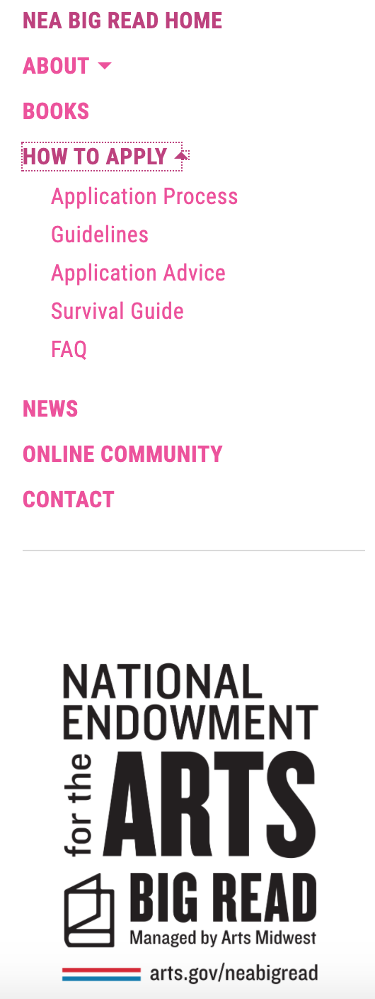
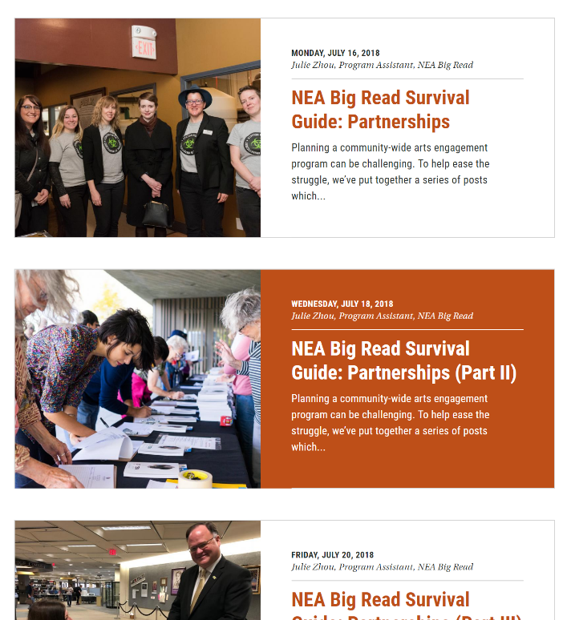
Notes:
A common question we get from applicants is “What has been done for this book before in terms of programming? Or, more generally, what kinds of events are done for this book?”
We’ve developed a number of resources to help answer this question too!
First off, we’ve been showcasing examples of NEA Big Reads from across the country on the Arts Midwest blog which you can get to by clicking on “News” In fact we’re releasing another one very shortly about a community that pivoted their programs during the pandemic.
We’ve also written some posts that are more geared toward applicant audiences in terms of strategizing during the proposal phase. We’ve dubbed these posts the “survival guide.” You can find it in the dropdown menu under “How to Apply.” They are centered around the topics of partnerships, marketing and promotion, and programming ideas. Check them out if you need some tips in those areas.
We’re also happy to talk to you directly in a 15-minute or so conversation. We’ll throw up our contact information towards the end of the presentation.

Slide 14
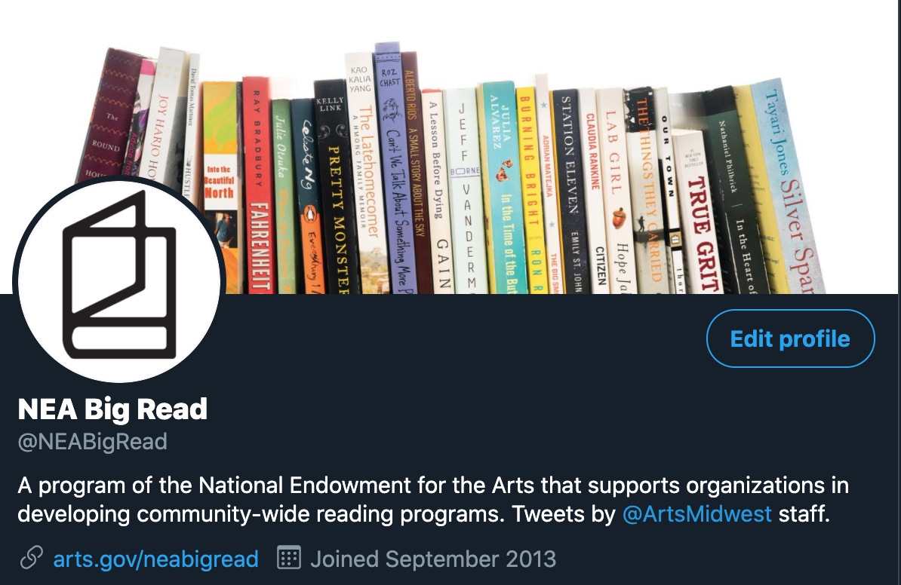
Social media
Twitter
#NEABigRead
Notes:
We encourage you to follow us on Twitter for all the latest updates and stories about the program. You can also search the hashtag on your social media platform of choice to see more of what grantees have done in the past with a grant.
Speaking of which, I’m going to hand it over to our guest speakers in a minute. We wanted them to speak to y’all about their wonderful community engagement projects since that’s a direction we are encouraging more this year: gathering community stories and showcasing them in some way as they relate to the themes and content of the book you’ll select. Their examples involve partnerships with their local media outlets. Just know that we don’t want you to feel overwhelmed about doing this component of the program at the level they demonstrate. You should use the resources available in your community and do what makes sense and that aligns with your organizational capacity.
Our first speaker is Erin Hollowell, from Alaska who will share more about some of the community engagement programs she coordinated for their NEA Big Read back in 2013.

Slide 15
Q & A
Use the Q&A box and we’ll address as many of your questions as we can.
If we don’t get to it, or it’s too specific, we’ll follow up!
Notes:
Before we get into the nitty gritty, I just want to make sure that I address the question of eligibility since we get asked this a lot.

Slide 16
Contact us
Arts Midwest
Hours of operation: Monday-Friday 8:30am-5:00pm Central Tel: 612.238.8010 neabigread@artsmidwest.org
Notes:
We hope you enjoyed this presentation, got some insight as to the application process, and maybe even a few programming ideas to put into your proposal

