Slide 1
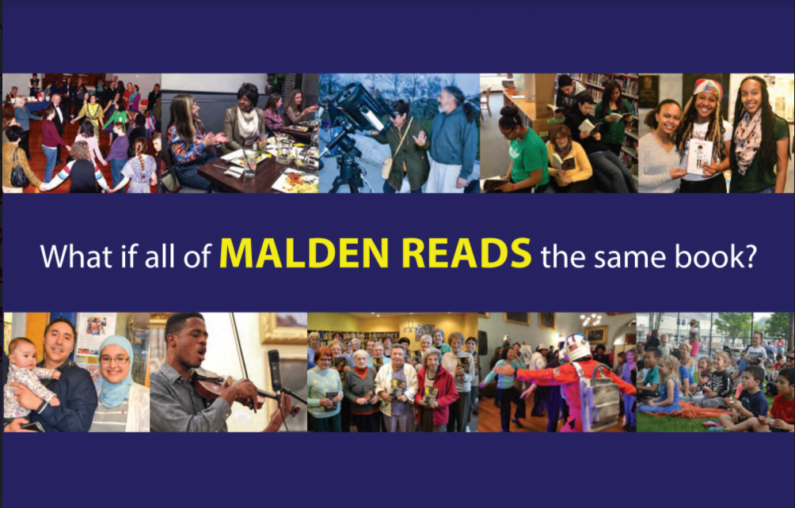

NEA Big Read: Sharing Stories
November 12, 2020

Slide 2
Malden Reads Introductions
Background
  Organized by volunteers, in collaboration with Malden Access TV (soon to be Urban Media Arts) and Malden Public Library, now entering our 11th year
  2020 NEA Big Read grantee for “Fahrenheit 451” by Ray Bradbury
  5 square miles city-wide; 5 miles north of Boston; 61,000 residents
  Most diverse high school in MA, and > 60 languages spoken at high school
Malden Reads website and social media
  www.maldenreads.org | www.flickr.com/photos/maldenreads/
  https://www.facebook.com/maldenreads | @maldenreads
Co-facilitators:
  Anne D’Urso-Rose, anne@matv.org
  Jodie Zalk, jzalk@alumni.uchicago.edu

Slide 3
Collecting & Sharing Community Stories through Digital Content
Mass. Memories Road Show photo archive (in collaboration with UMass Boston)
http://bit.ly/malden-stuck-at-home
Podcast series (in partnership with MATV/UMA)
www.maldenreads.org/podcast/
Storytelling workshop (in partnership with MATV/UMA and local artist)
https://bit.ly/38ckZuf
Filmbuilding workshop (in partnership with MATV/UMA)
https://bit.ly/38aBjeT
Also - MATV/UMA Digital Social Wall
https://matv.org/maldentogether2/wall/

Slide 4
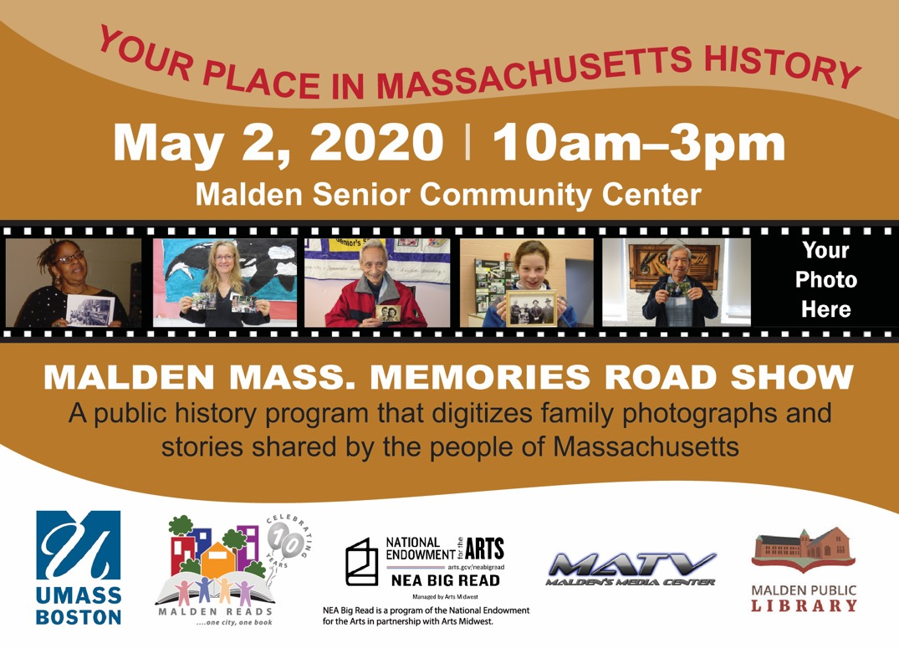
Malden Mass. Memories Road Show

Slide 5
Mass. Memories Road Show
What’s the Mass. Memories Road Show?
Why is Malden Reads participating in it?
A project of UMass Boston, launched in 2004
Statewide, event-based participatory archiving project
Documents people, places, and events in MA history through family photographs and stories
> 11,000 photos and stories, creating an educational resource of primary sources for future generations
To collect a time capsule of oral histories and personal photos that tell the rich history and current story of Malden
To create a community history program
To complement our 2020 book selection, “Fahrenheit 451” by Ray Bradbury
  Protagonist Guy Montag and dissidents were exploring how to preserve and collect memories and stories.

Slide 6
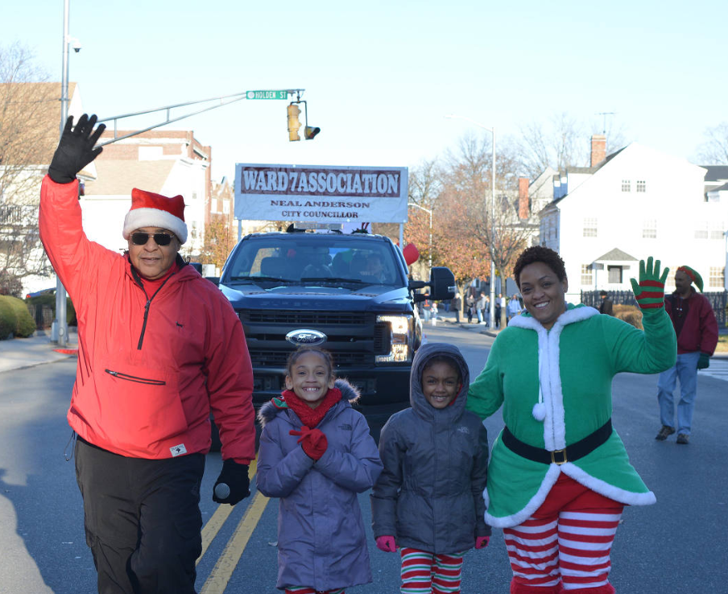
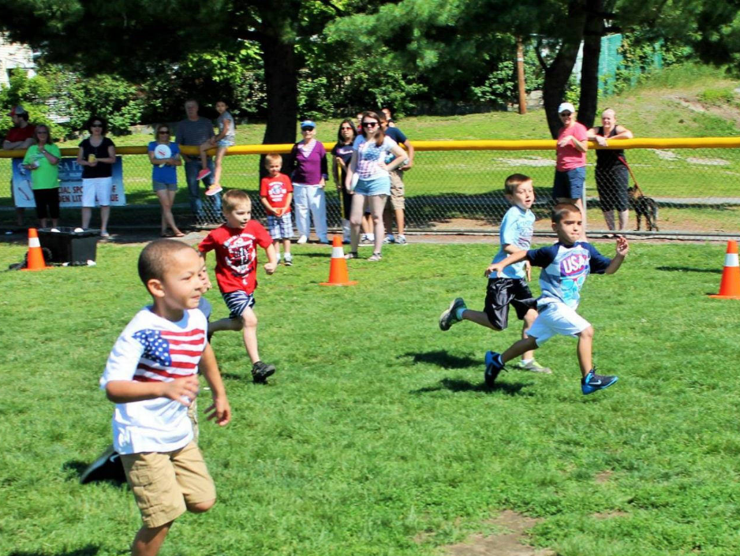
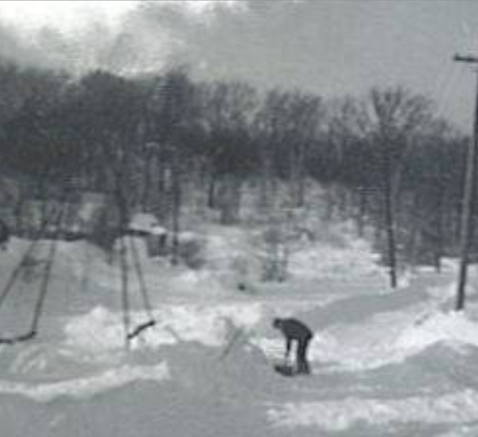

Slide 7
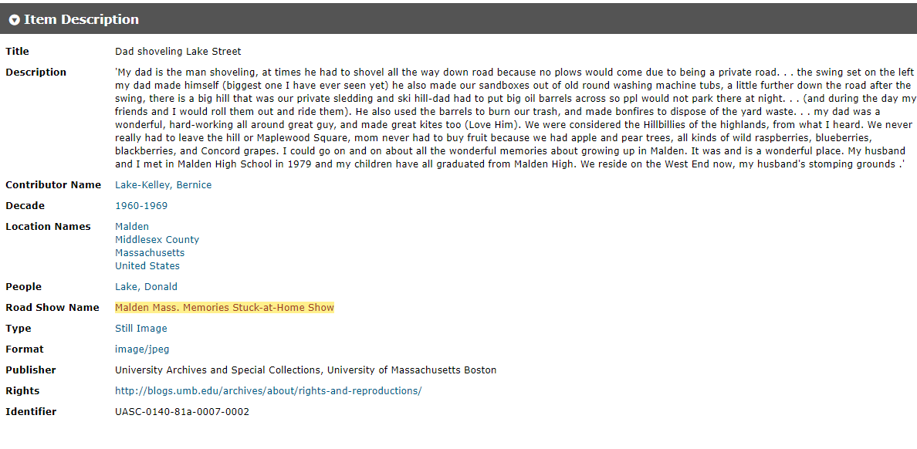

Slide 8
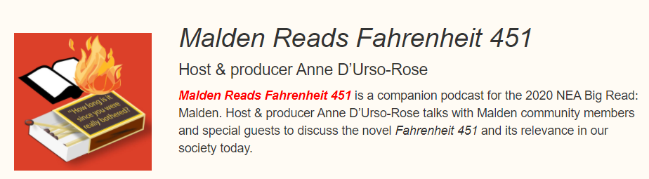
Podcast Series

Slide 9
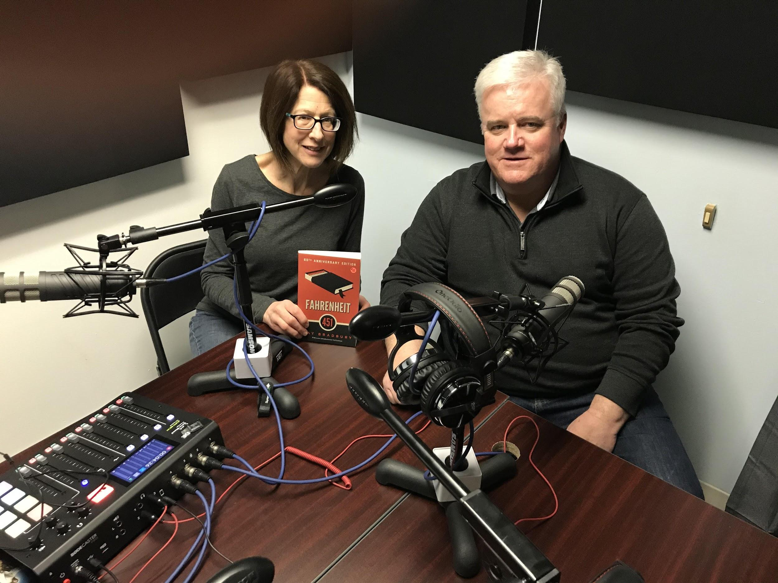
Podcast Series
Four episodes
  Searchable on major podcast apps, and
  can play directly from our website
Recorded at MATV/UMA studio
Special guests:
  Malden Deputy Fire Chief Bill Sullivan
  Elena Martinez, Designer-Founder of Artfort Design Studio
  Malden Mayor Gary Christenson
  Rev. Otto O’Connor, Minister at First Parish Malden
Positive community reception of series

Slide 10
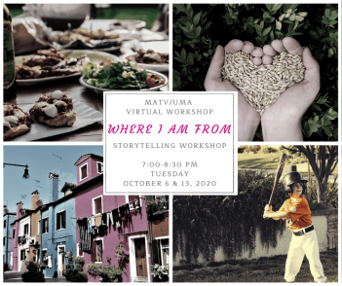
Storytelling Workshop

Slide 11
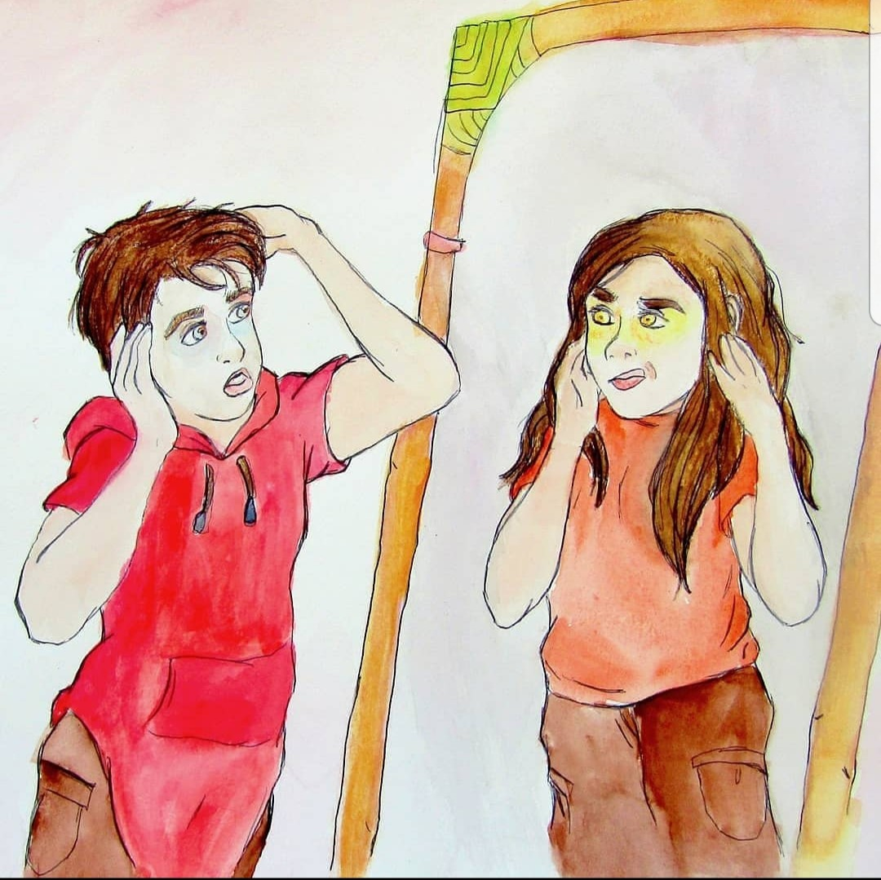
Storytelling Workshop
Taught by a local writer/spoken word artist
Intentionally diverse group of participants
(through targeted outreach)
Ice breaker & writing exercises
Each writes a “Where I’m From” poem
Hone personal stories
(like NPR’s “The Moth”)
Virtual presentation of stories/poems
Used personal photos & illustrations for
slideshow at virtual presentation
Artwork by Sky Malerba
“Where I’m From” participant

Slide 12
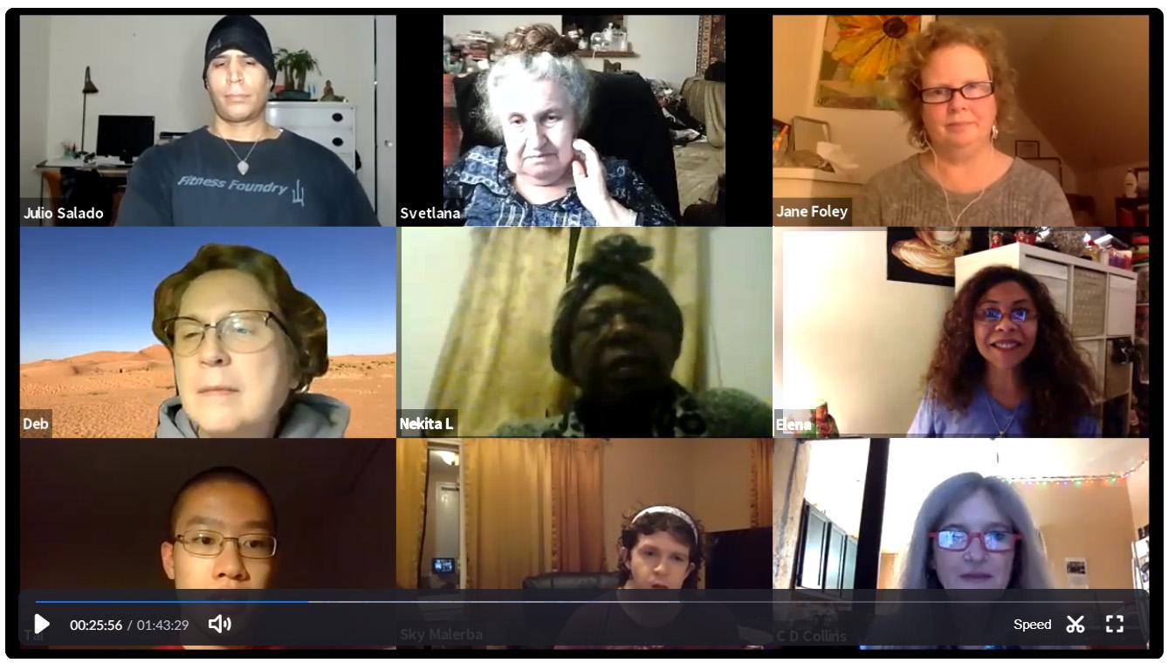
Storytelling participants in virtual workshop

Slide 13
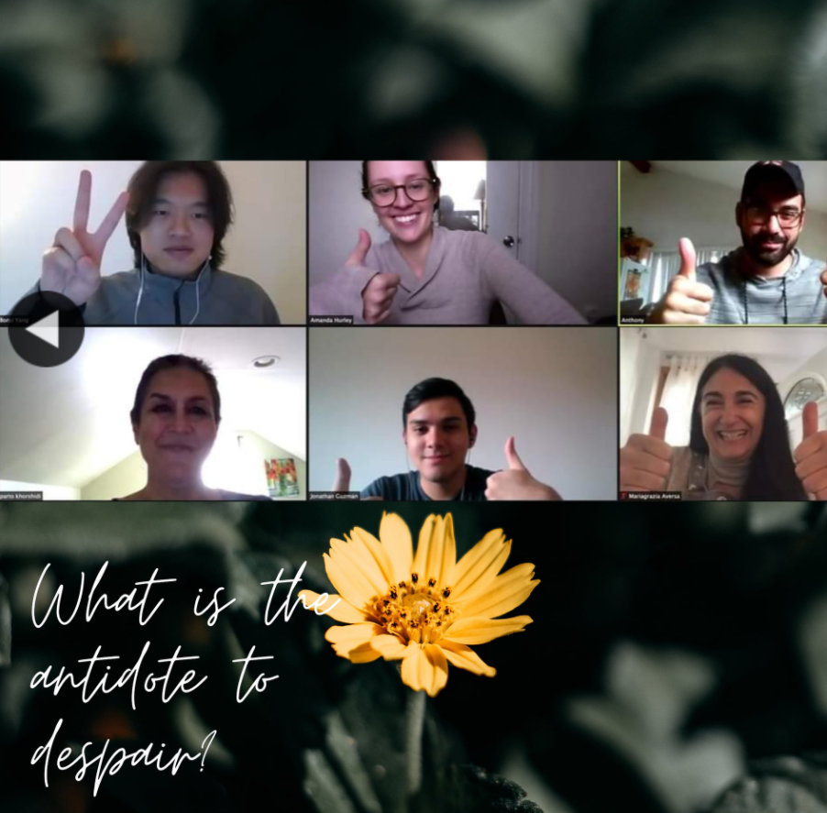
Filmbuilding Workshop

Slide 14
Filmbuilding Workshop
A diverse group of Malden residents meet virtually to co-create a film based on a theme inspired by the book.
They use their own cellphones or electronic devices to shoot footage on their own or to meet in a socially distanced setting.
Under the guidance of a film mentor, they edit their footage using the collaborative online software “WeVideo”
A virtual public screening is held to prompt thought and discussion and to allow the filmmakers to share their experience.
The collaborative filmbuilding process bridges age, race & cultural boundaries & builds community.
Examples of films created: “The Urge of Now”
“A Life Well Lived”

Slide 15
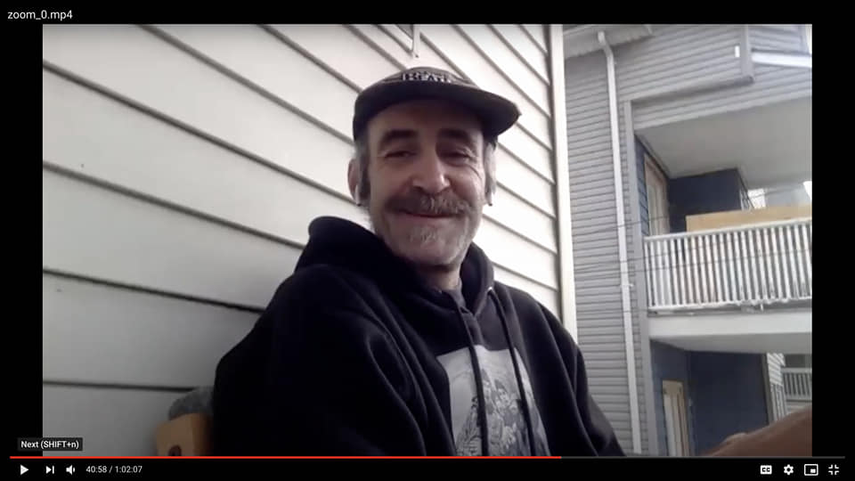
Filmbuilding Workshopp

Slide 16




COLLABORATIONS
ARTISTS
FILMMAKERS
AUTHORS

Slide 17

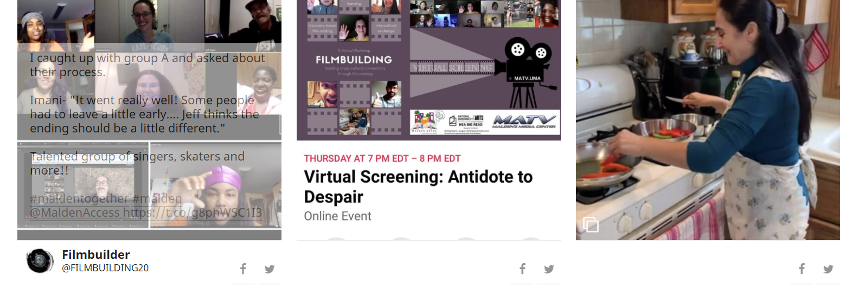
MATV/UMA Digital Social Wall

Slide 18
MATV/UMA Digital Social Wall
Online program that aggregates posts from social media via a hashtag. You can also curate and add media directly.
The Social Wall “lives” on the MATV/UMA website.
We send out prompts to the community on various topics to generate posts to add to the social wall.
Documents and archives this unique time in our community’s history
Software: Walls.io or Curator.io
Link to #MaldenTogether Wall: https://matv.org/maldentogether2/wall/

Slide 19
SHARING STORIES
MAKES A DIFFERENCE
Good luck sharing in your communities!

